Slide 1
CAMPAIGN
at LEHIGH VALLEY
Ryan Abramson
July 31, 2025

Slide 2
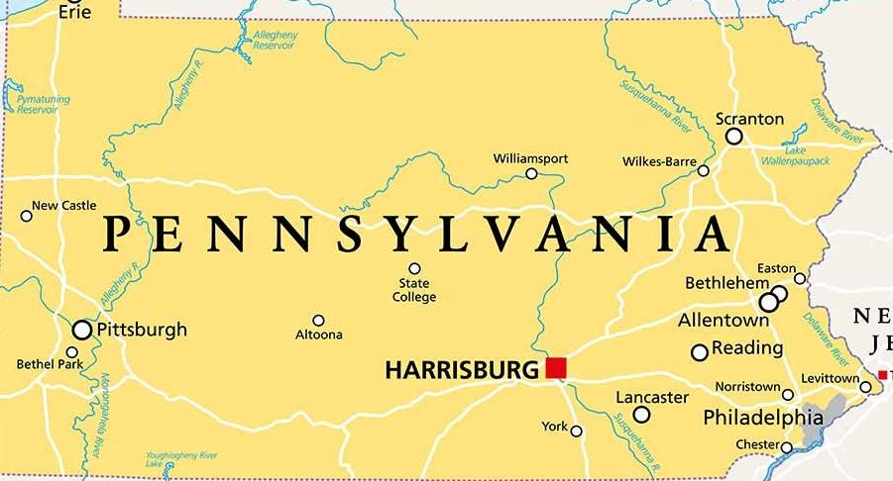
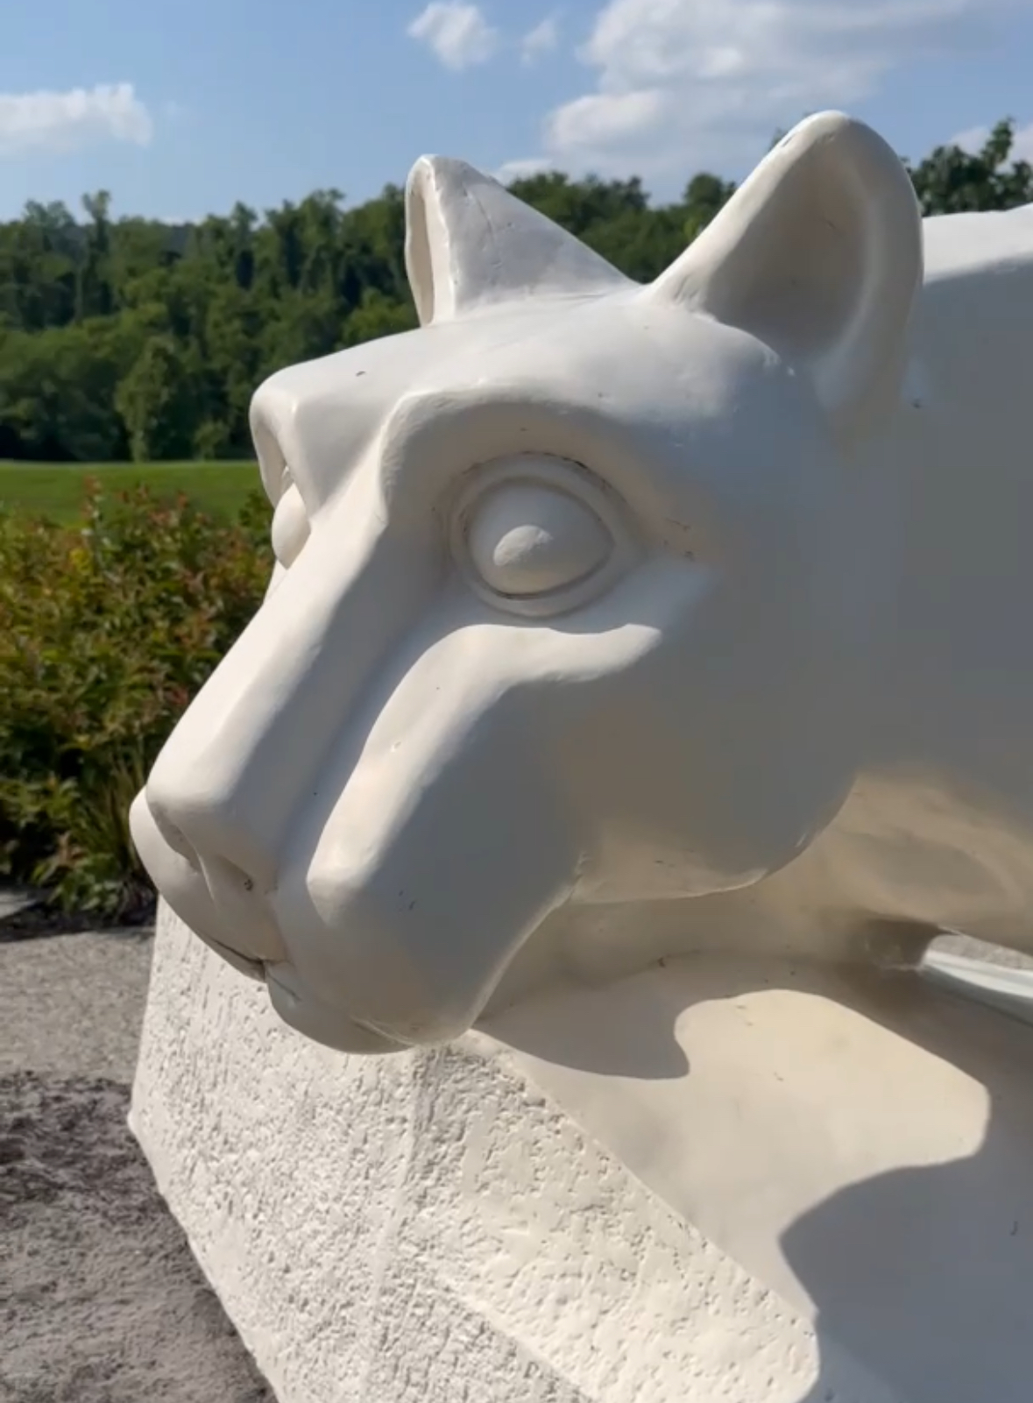
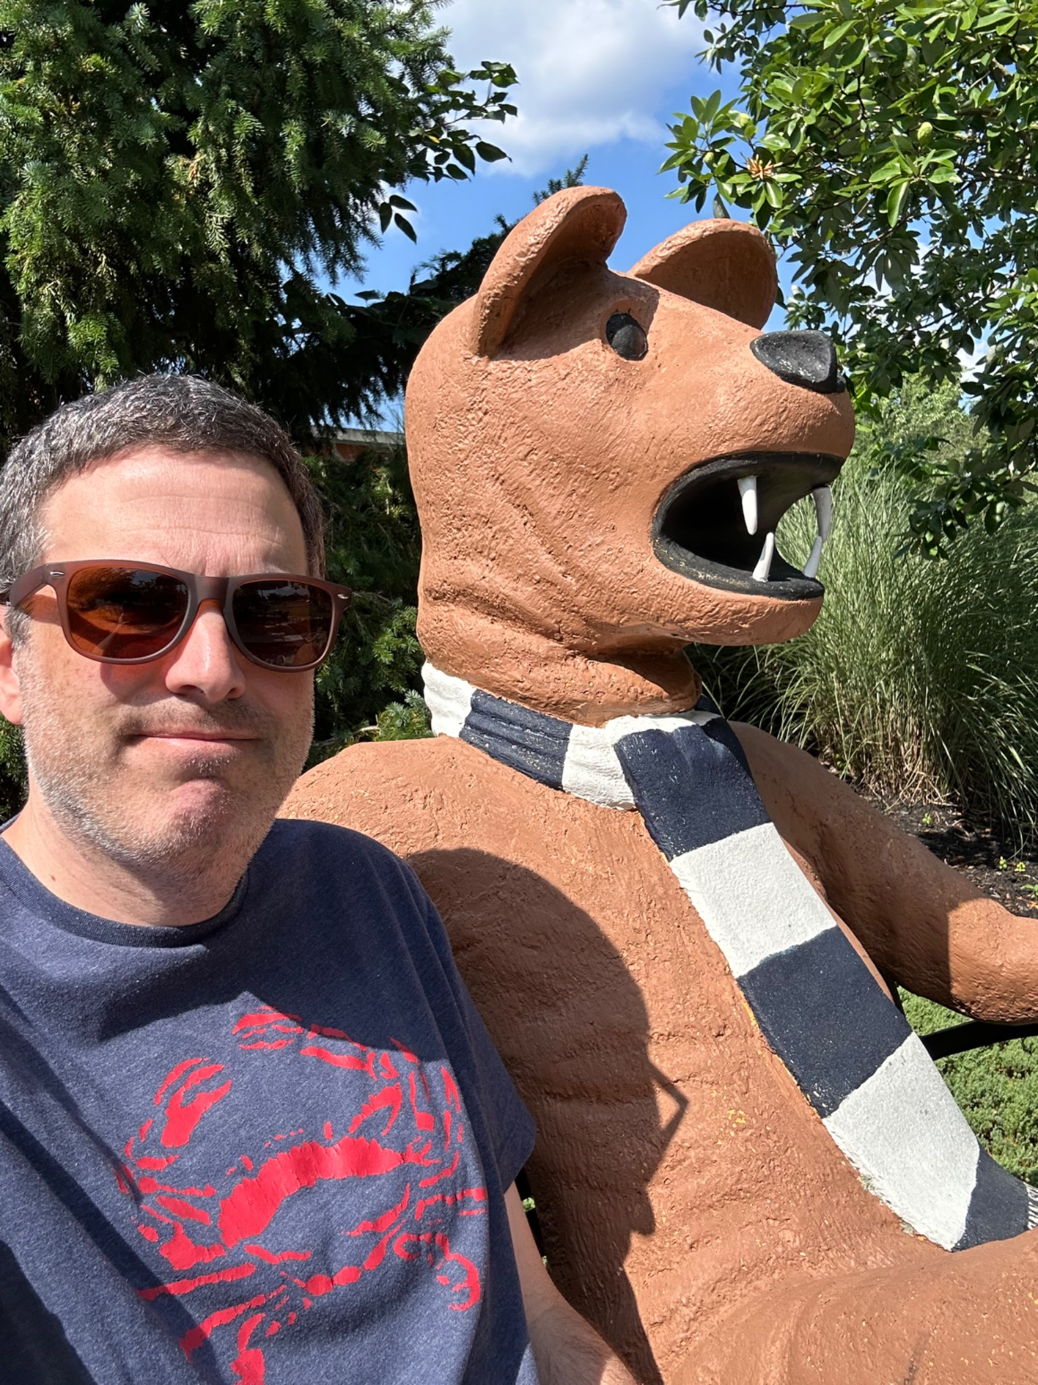
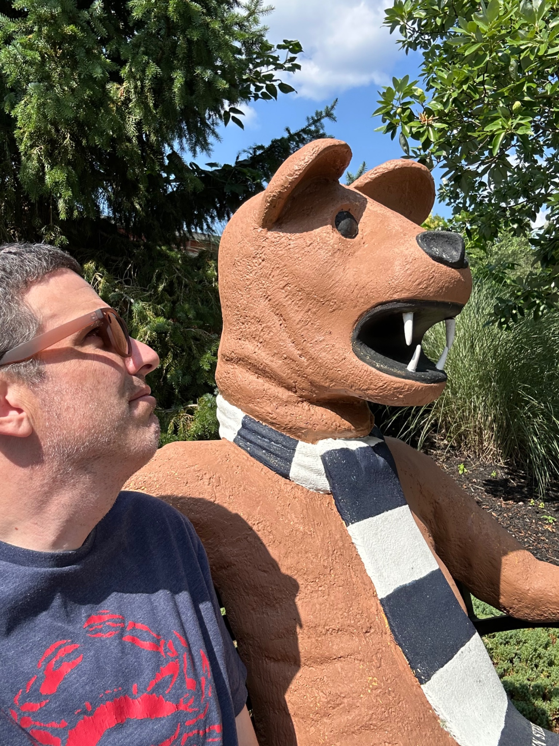
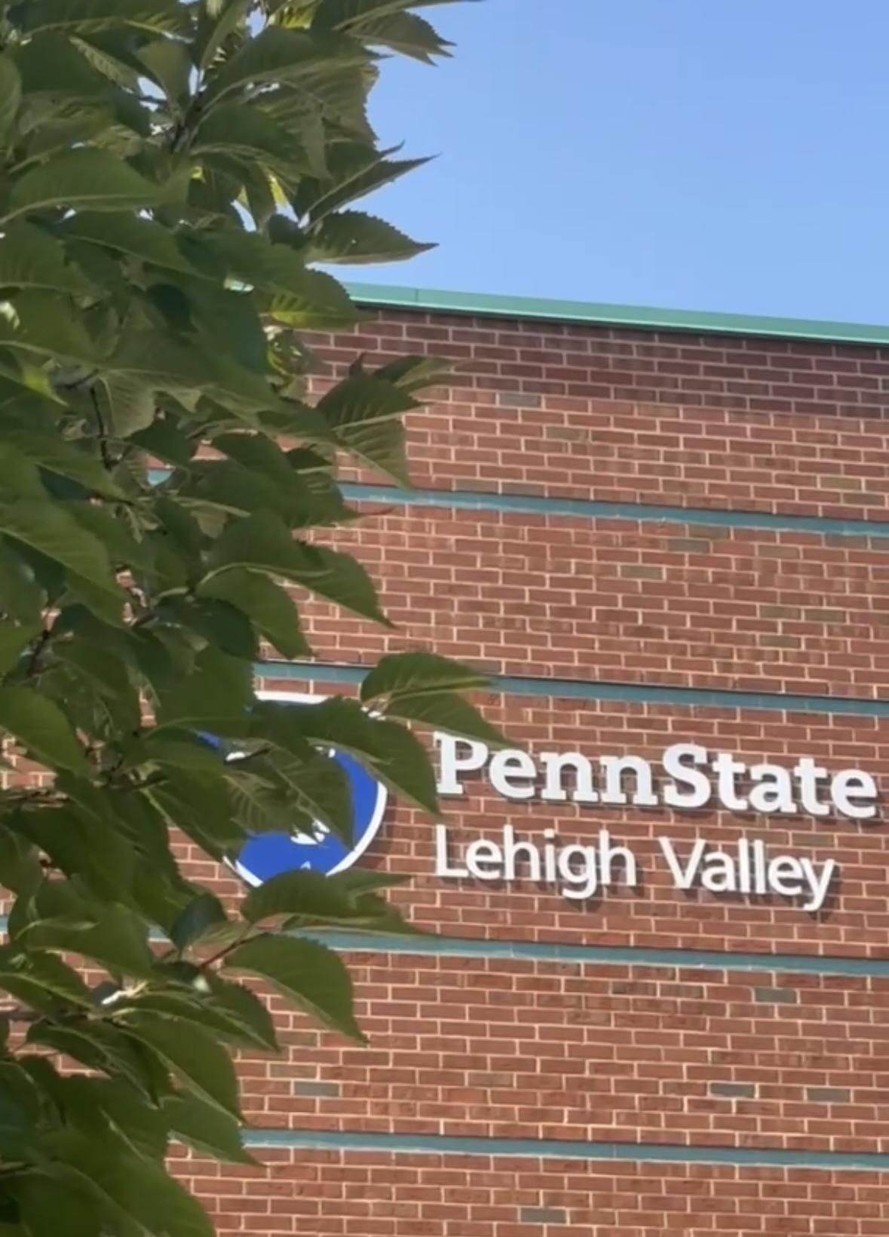
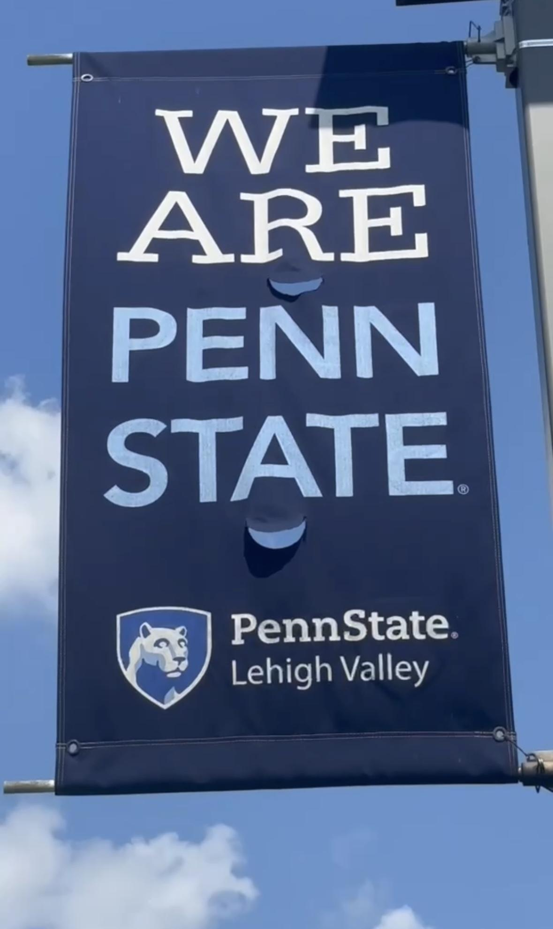
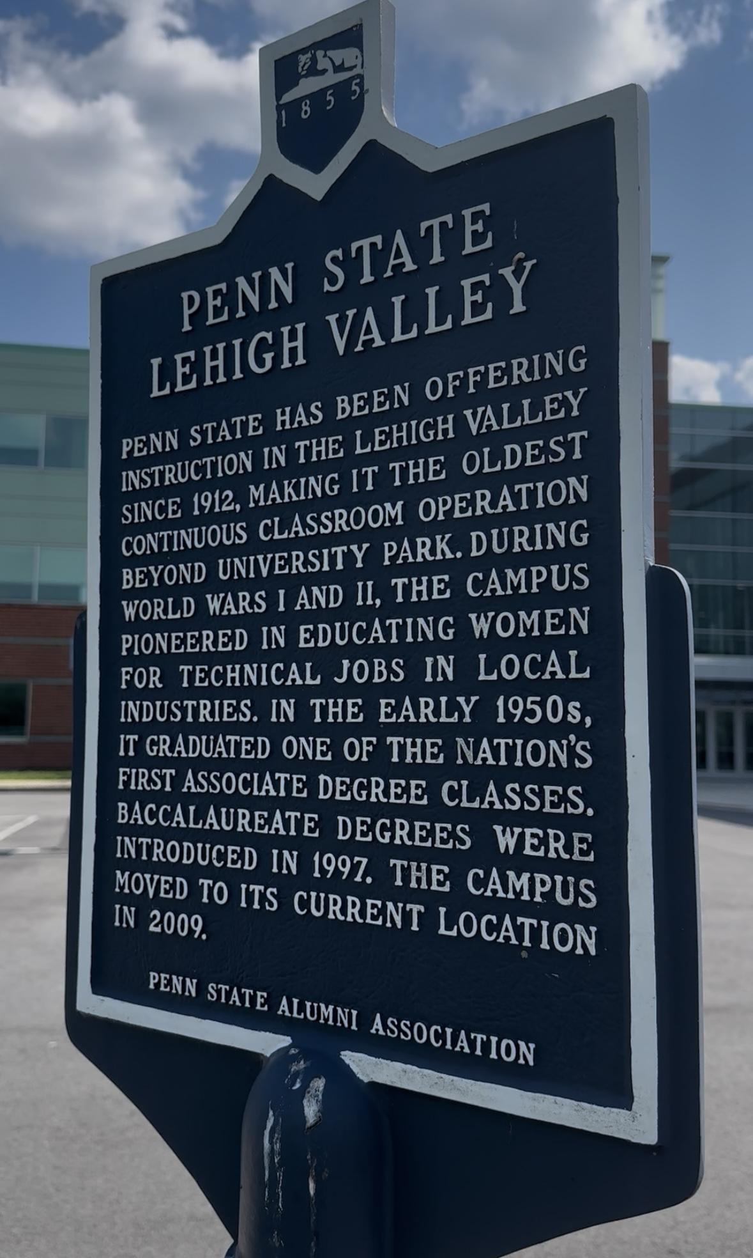

Slide 3
AGENDA
01
BACKGROUND & OBJECTIVES
03
ENROLLMENT, ALUMNI, COMMUNITY PARTNERS
02
Goal
Tactics
Measures
HIGH LEVEL DATA,
INFORMED VISION
& CAMPAIGN THEME
04
CLOSING /
QUESTIONS &
ANSWERS

Slide 4
01
Background, Objective and North Star

Slide 5
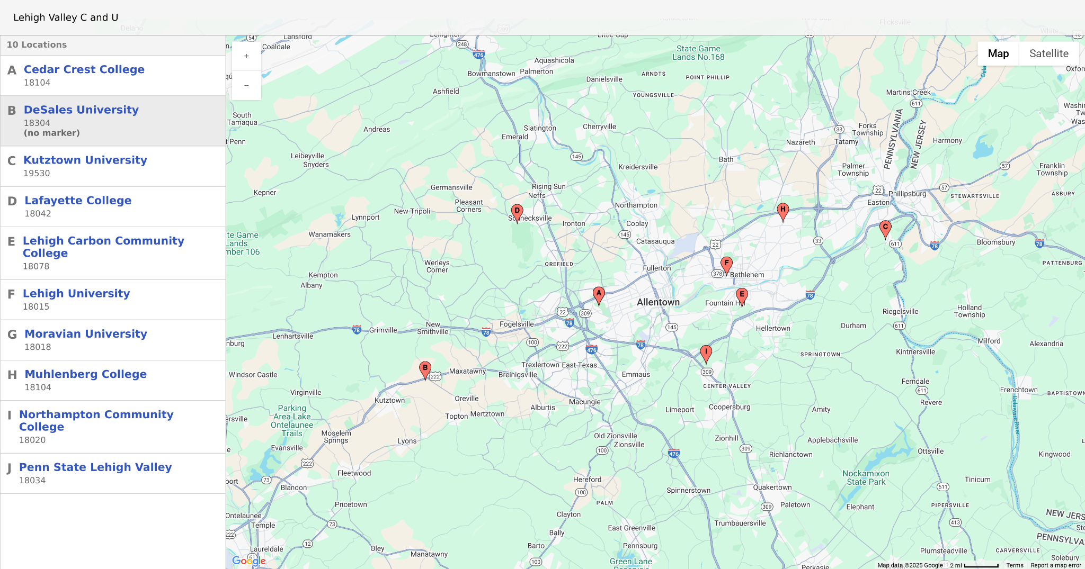
BACKGROUND
Enrollment Pressure
Geographic Competition
Higher Ed Consolidation
Value of a College Education

Slide 6
OBJECTIVE
DEMONSTRATE VALUE TO PROSPECTIVE STUDENTS, ALUMNI (Donors) and COMMUNITY LEADERS

Slide 7
NORTH STAR(s)
01
02
03
04
Academic Excellence
Engaged Learning
Respect for All
#WeAre

Slide 8
02
Data, Vision, Theme

Slide 9
DATA: Who #WeAre
VALUE DRIVEN
NEXT GEN LEARNERS
Penn State Lehigh Valley offers an affordable degree completion path without the limitations of a community college.
A college student who lives at home, juggles school, work, or family, and still wants a legitimate, opportunity-rich national university experience
ROOTED AND RISING
VALLEY VISIONARIES
Rooted in the Lehigh Valley and rising with the strength of the Penn State brand, our students and alumni tap into powerful local connections that open doors to career advancement and long-term success.
The Valley Visionaries are our most committed champions—local leaders, employers, and advocates who help our students rise by opening doors, offering support, and spreading the word. Together, we’re building a stronger Lehigh Valley

Slide 10
Vision
Own Next-Gen learner market in the Lehigh Valley
Use positive and brand-unique language
Prioritize evergreen strategies for efficient use of the impulse window, time and budget.
Resource efficient, leveraging existing platforms and relationships (in year one).

Slide 11


Slide 12
03
Enrollment, Alumni, Partners

Slide 13
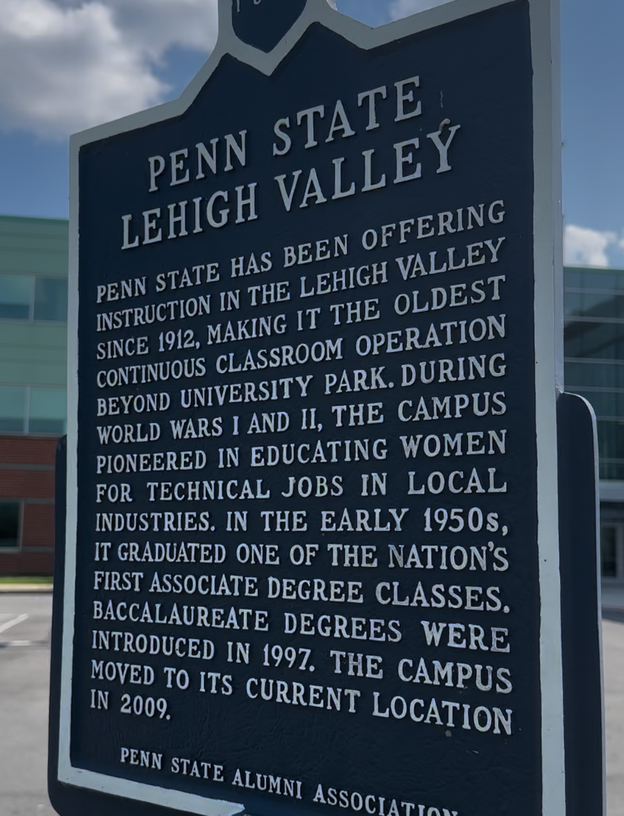
“I feel a deep sense of purpose. Everything led me to this moment.”- Murtaza Jaffer
Alumni features can drive enrollment - business partnerships can increase visibility and giving - emotion can drive decisions.

Slide 14

INCREASE STUDENTS FROM BUCKS COUNTY
(2024: Abington 672 / LV 67)
GOAL
TACTIC
DEPLOY A MULTI-PLATFORM GRWM CAMPAIGN
NexGen Learners/Flexibility. (Life/Work)
Value Driven. (Cost)
Opportunities. Connections to local business and employment
MEASUREMENT
Enroll 10 new 4-year students for 2026-27
Greatest flexibility with new, returning, late to start students.
ENROLLMENT
RISING IN THE VALLEY

Slide 15
FOCUS ON LOCAL ALUMNI ENGAGEMENT
GOAL
TACTIC
FRIDAY FOCUS
Celebrate PSLV engaged alumni every Friday
Social, Video, Long Form Storytelling
Encourage sharing to increase awareness and grow needed content and leads.
Semester Friday event (coffee, lunch, etc)
MEASUREMENT
By May 2026, increase social engagement by 5%; measured by shares on major platforms over established base data from prior year..
ALUMNI AND GIVING
ROOTED AND RISING

Slide 16
SUSTAINED LOCAL SUPPORT FROM BUSINESS LEADERS, CIVIC LEADERS, ELECTED OFFICIALS
GOAL
TACTIC
CREATE VALLEY VISIONARY AWARD
Recognition of supportive partners
Value in the exclusivity
Increase in unique media coverage
Strategic use in other growth initiatives
MEASUREMENT
Initial 4 person class, followed by a once a year award. Engage previous winners in process.
COMMUNITY PARTNERS
VALLEY VISIONARIES

Slide 17
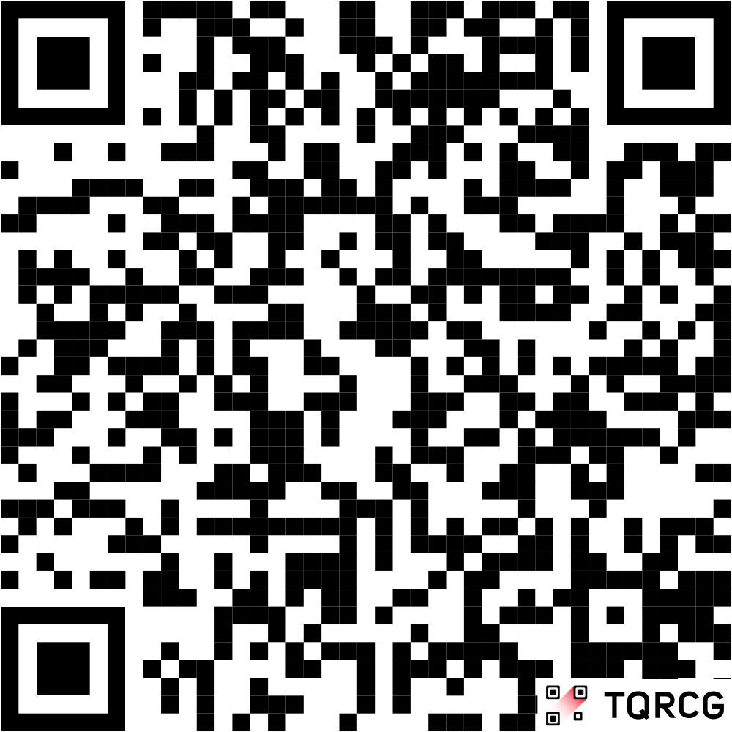
Click Here

Slide 18
QUESTIONS and ANSWERS

